Slide 1
HEP-Frame
27/05/2019
A Development Aid and Efficient Execution Engine where a Multi-layer Scheduler Adaptively Orders
Pipelined Data Stream Applications
Candidate:
André Pereira
Advisors:
Prof. Alberto Proença
Prof. António Onofre

Slide 2
Agenda
Motivation
Pipelined Data Streaming
Parallel Computing Environments
HEP-Frame: Highly Efficient Pipelined Framework
Case Study to Validate & Evaluate HEP-Frame
HEP-Frame Performance Evaluation
Conclusions & Future Work
Scientific Contributions

Slide 3
Motivation
Develop tools for performance tuning
Focus on code once and execute on any platform
Help computational scientists
Innovative contribution to Computer Science
HEP-Frame & novel scheduling approaches

Slide 4
Pipelined Data Streaming
Notes:
Various alternatives to read and initialize inputs – Data Setup
Batch
Mini-batch
Streaming
ORDEM DAS PROPOSIÇÕES
Data is independent
Data Processing organized in a pipeline of multiple stages
Computational task followed by the evaluation of a criterion - a proposition
Computational complexity of propositions may vary
Order is important
Pipeline can be
Compute-bound
Memory-bound
I/O-bound
Proposition order in the pipeline is crucial
For code correctness - dependencies among propositions
For code efficiency

Slide 5
Common Parallelisation Approaches

Slide 6
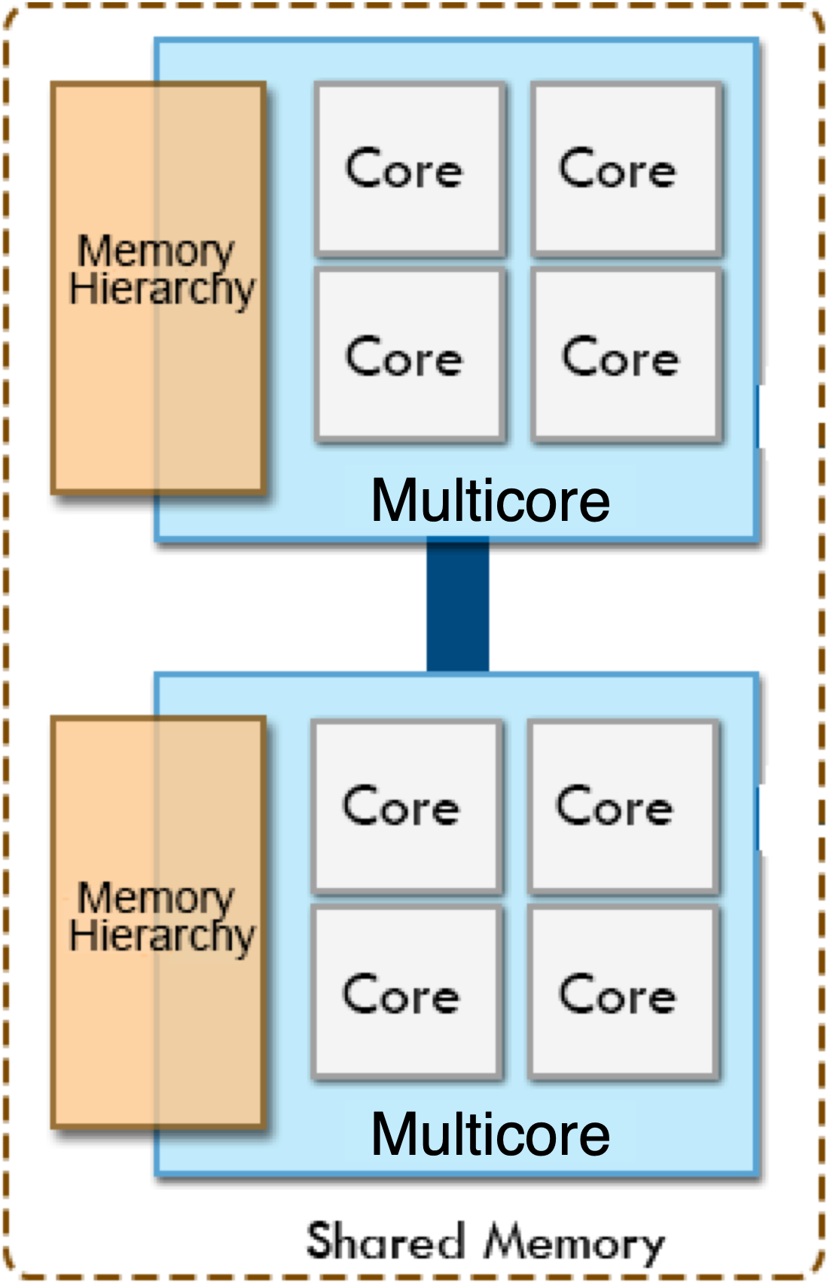
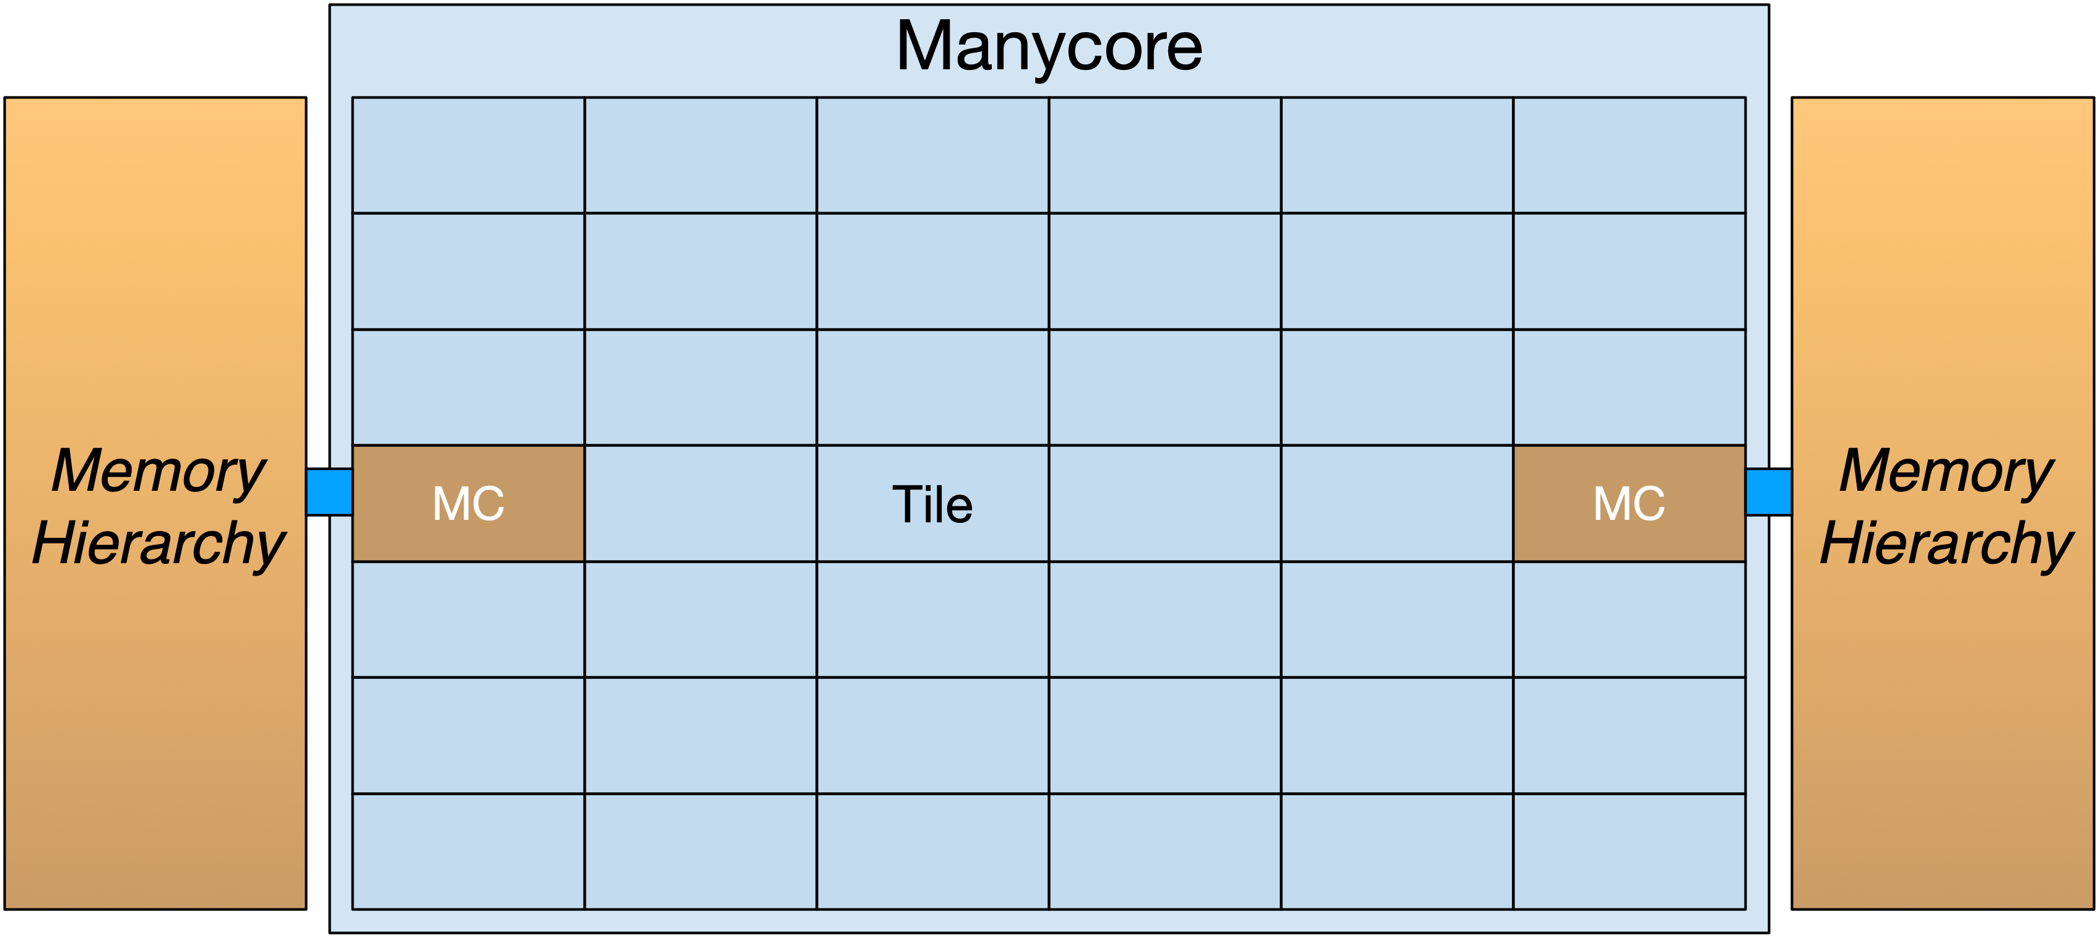
Homogeneous Compute Servers
Typical Multicore server (up to 32-core per device)
Typical Manycore server
(over 60-core per device)
Notes:
To produce efficient code we cannot only consider the code, but we also have to be aware of the HW its going to be used
- Falar do multicore e manycore, e o ambiente de programação em memória partilhada com NUMA

Slide 7
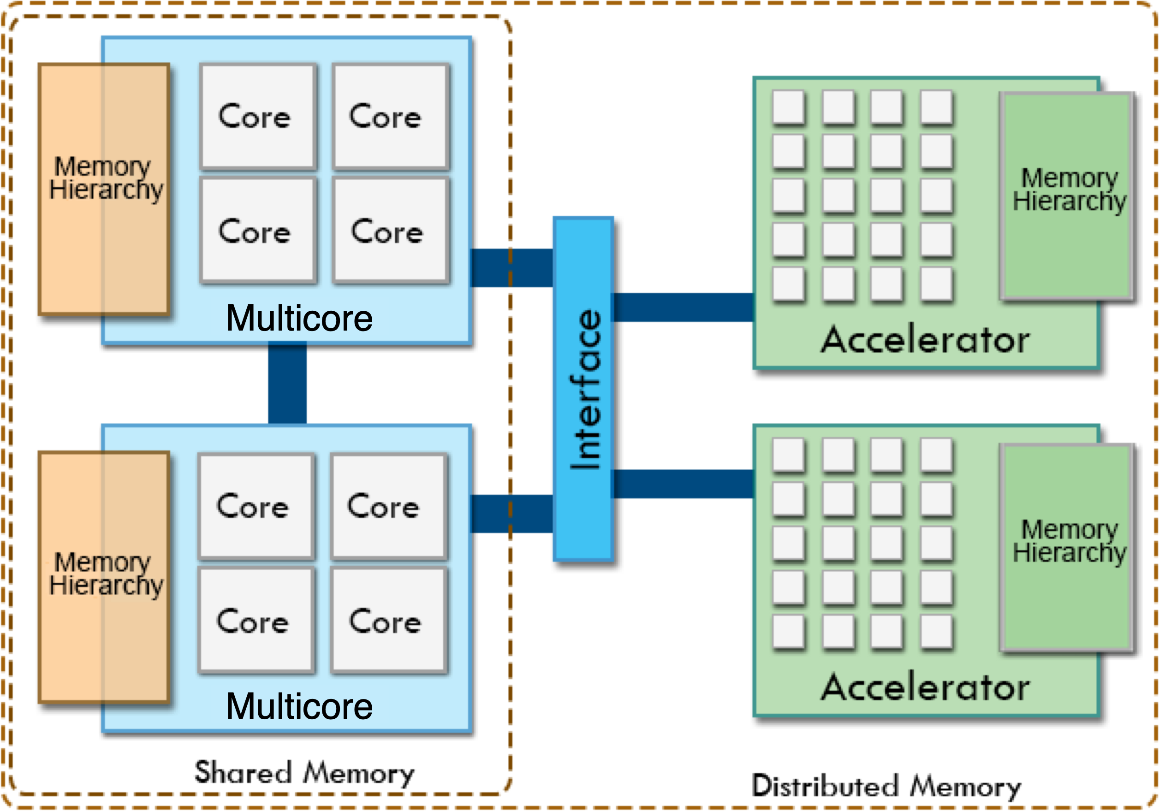
Heterogeneous Compute Servers
Notes:
- Falar da interface, memória distribuída e a noção de que os aceleradores são massivamente paralelos

Slide 8
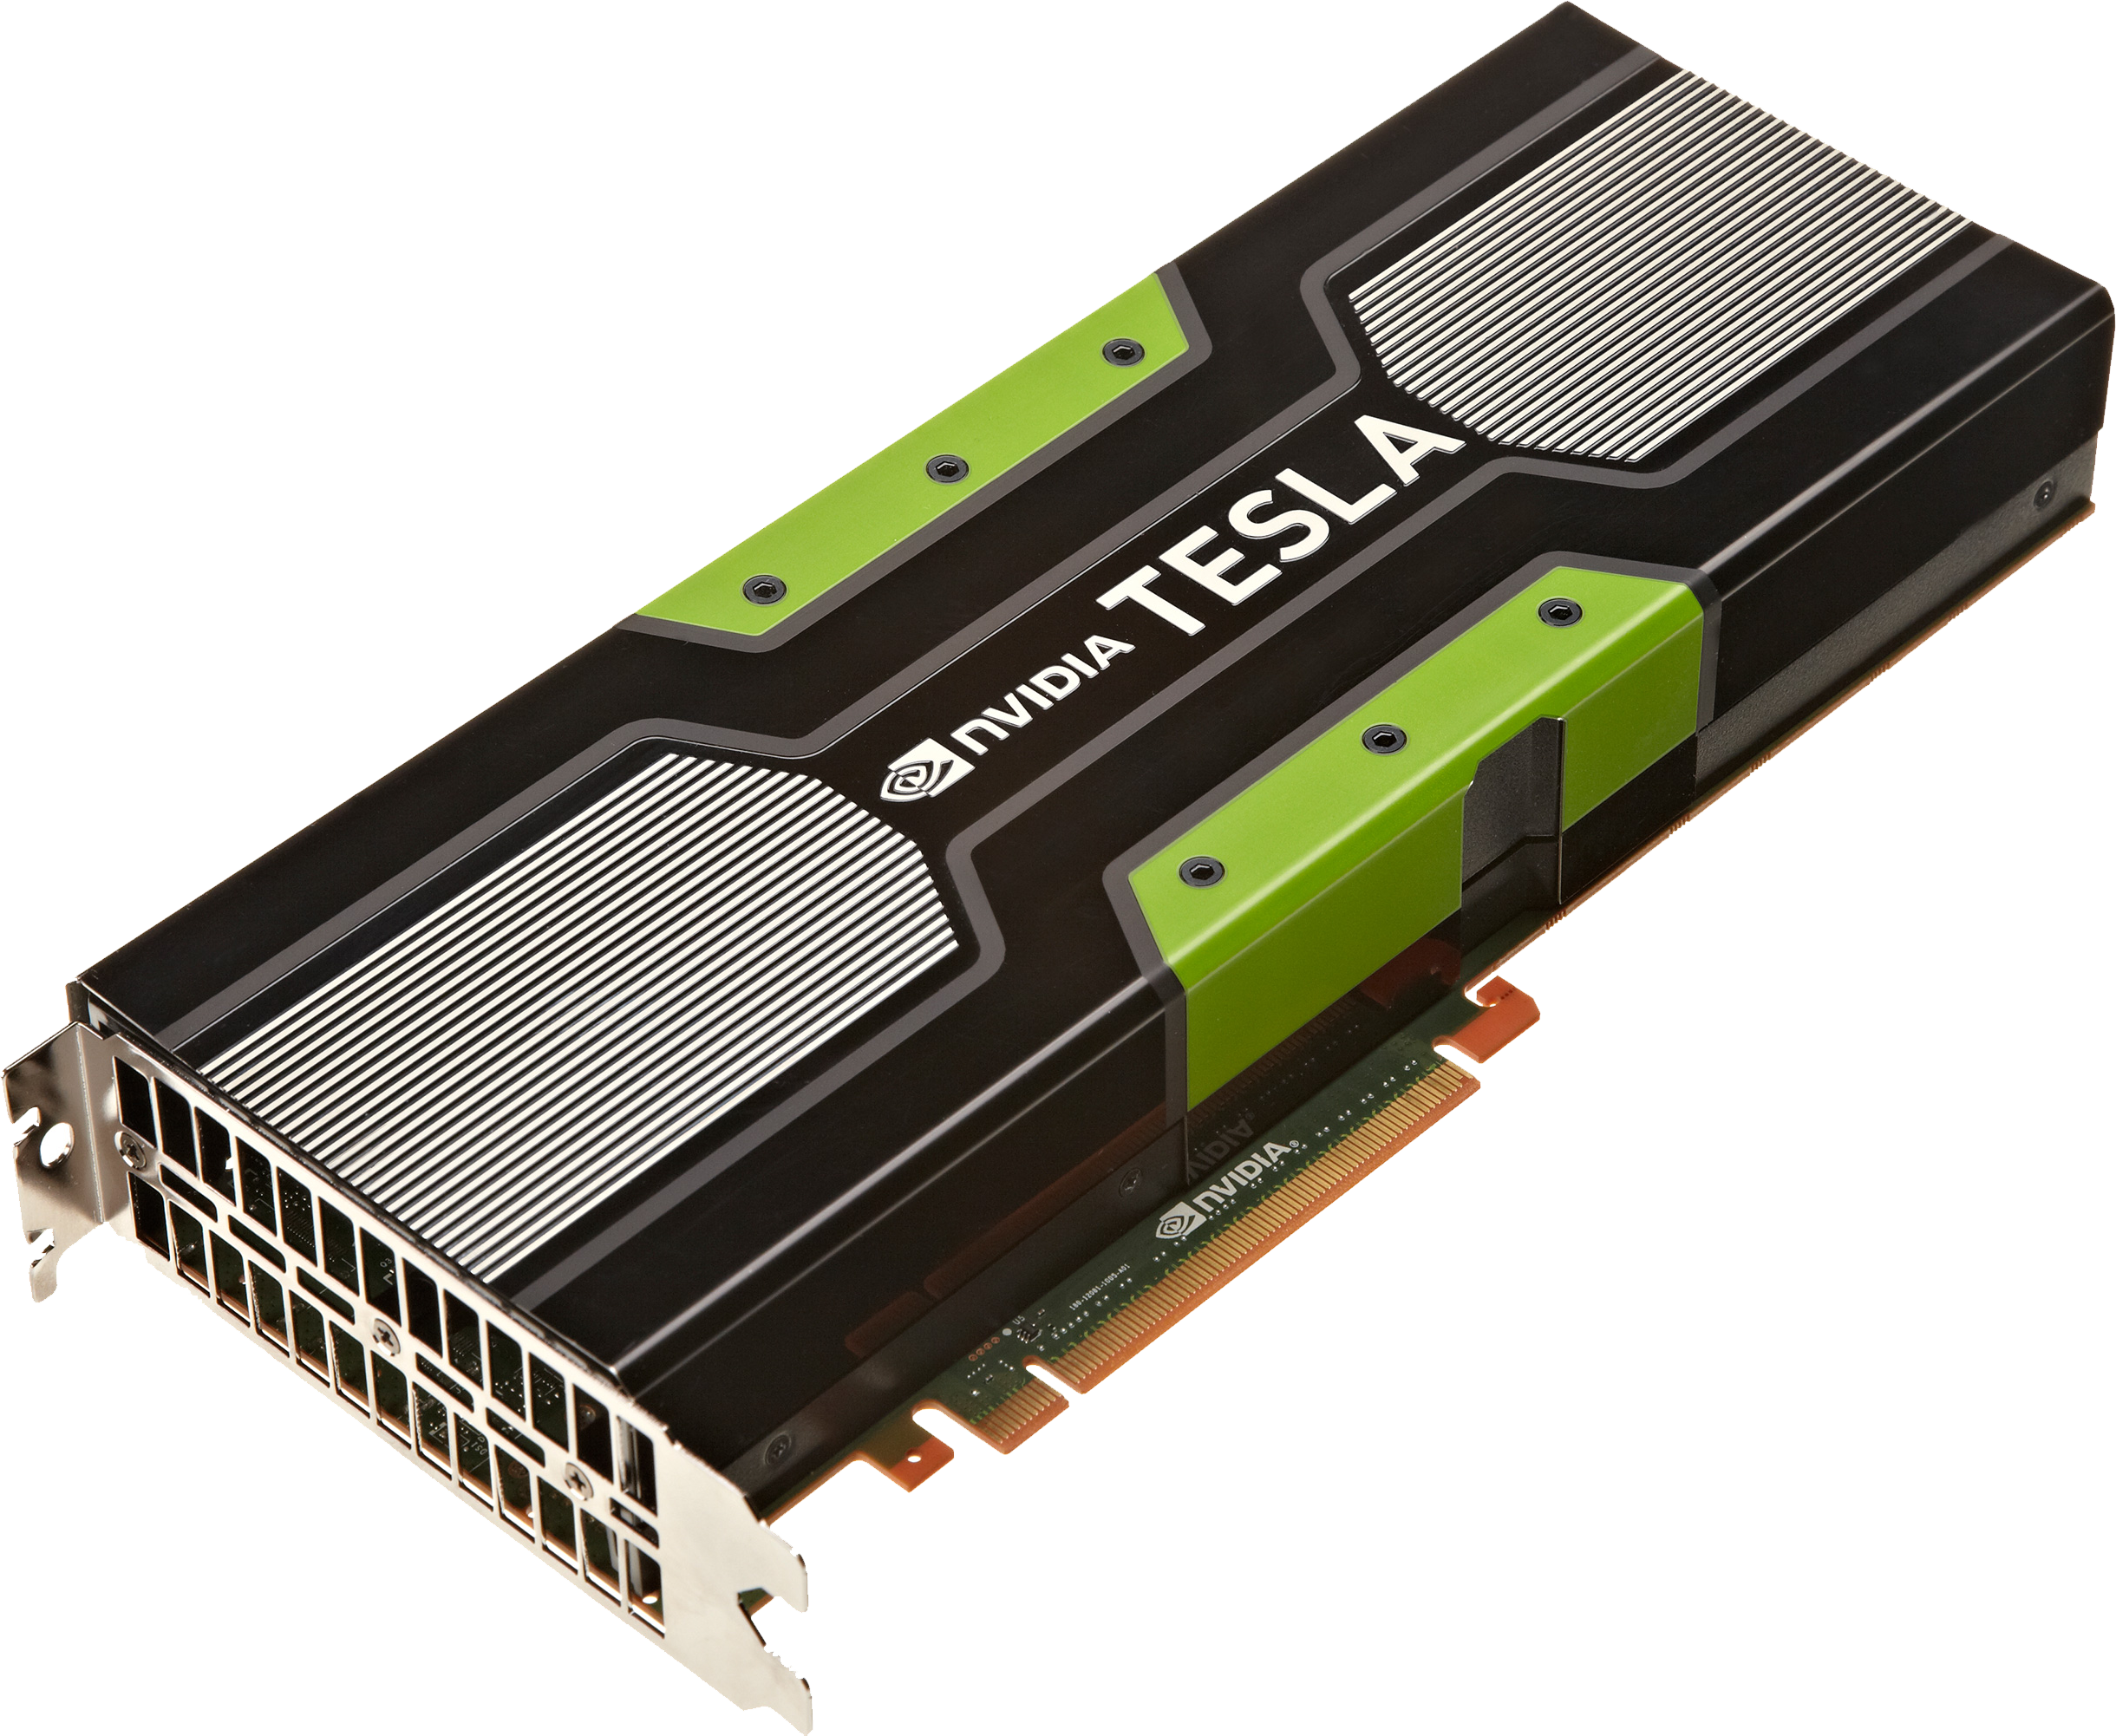
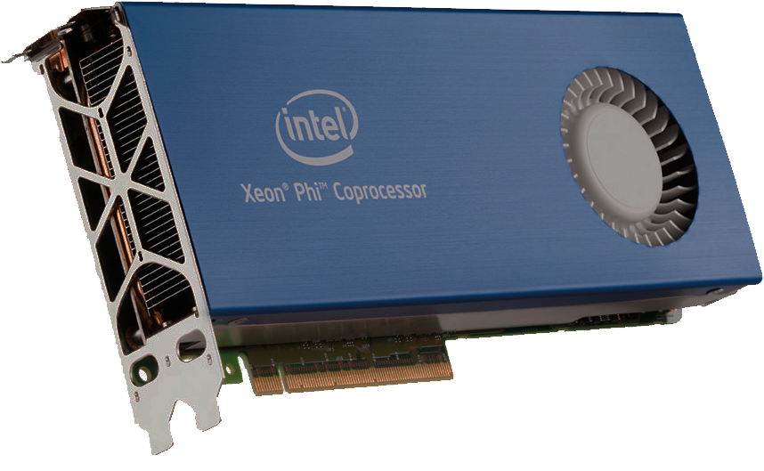
Heterogeneous Compute Servers
Notes:
Falar das diferentes características dos possíveis aceleradores (não dos detalhes de arquitectura): diferente arquitectura, paradigmas e linguagens de programação, restrições ao Código, etc…
Falar que os

Slide 9
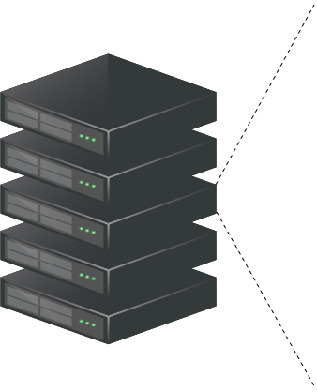
Heterogeneous Compute Servers
Notes:
Falar das diferentes características dos possíveis aceleradores (não dos detalhes de arquitectura): diferente arquitectura, paradigmas e linguagens de programação, restrições ao Código, etc…
Falar que os

Slide 10
Highly Efficient Pipelined Framework
HEP-Frame has two key goals
Aid the development of pipelined data streaming applications
Through the use of code skeletons
Hiding parallelization & scheduling from the user
Supports plugins in the compilation process

Slide 11
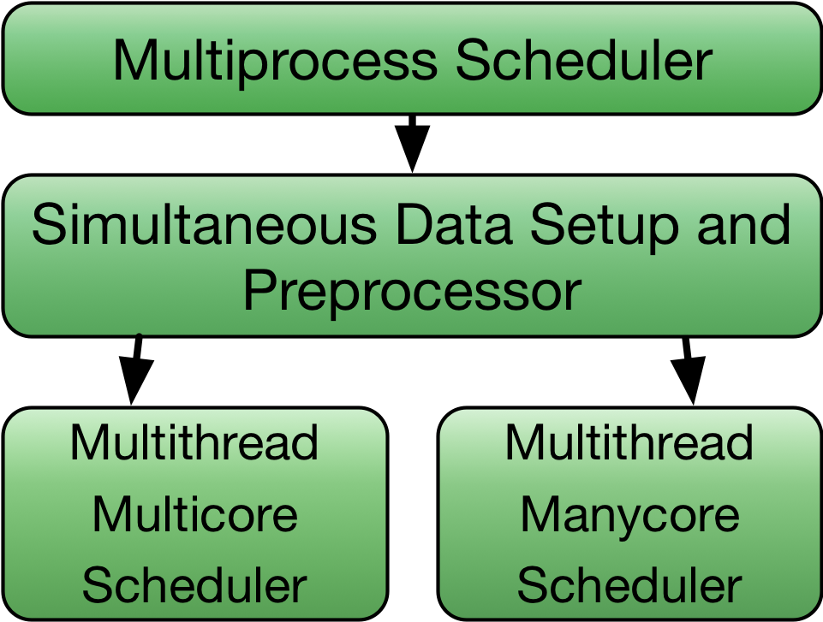
Highly Efficient Pipelined Framework
HEP-Frame has two key goals
Aid the development of pipelined data streaming applications
Efficient execution of the code
Multi-layer scheduler
Tuning compute intensive and frequently used libraries: PRN generation
Notes:
Focar mais nos últimos 2 níveis

Slide 12
HEP-Frame Multiprocess Scheduler
Multiprocess scheduler
Pool of independent input files shared among processes
Coarser workloads with very low overhead
Each process with an independent data structure

Slide 13
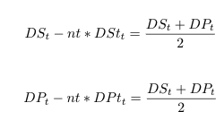
HEP-Frame DS/DP Scheduler
Simultaneous Data Setup and Data Processing
Dynamic tune of #threads allocated to these tasks
Adapts HEP-Frame to benefit I/O or computations

Slide 14
HEP-Frame Multicore Scheduler
Multicore scheduler
Creates a table of propositions according to dependencies
Assigns propositions from the table to threads
Updates position of propositions according to their weight

Slide 15
HEP-Frame Manycore Scheduler
Manycore scheduler
Creates a pipeline order based on dependencies
Updates proposition order according to their weight

Slide 16
HEP-Frame PRNG Management
PRNs are often required by pipelined data stream applications
PRNGs may have a performance impact when large amounts of PRNs are required
HEP-Frame transparently manages the efficient execution of PRNGs
Notes:
Adequate PRNG usage on parallel environments is crucial for application efficiency and correctness
Offload PRNGs to accelerators – currently for GPUs and Knights Corner devices
Frees computational resources in the host device – used for the application
Hides PRNG and memory transfer overhead through the use of PRN dual-buffers

Slide 17
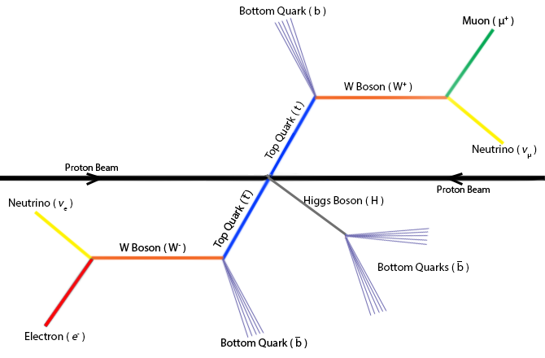
Case Study to Validate & Evaluate HEP-Frame
The ttH scientific data analysis has the key features to evaluate HEP-Frame
Notes:
The ttH scientific data analysis has the key features to evaluate HEP-Frame
It is a real application developed by non-computer scientists and is actively used
Has the structure of a pipelined data stream application
Small modifications to the code changes it behavior among I/O-, memory-, or compute-bound

Slide 18
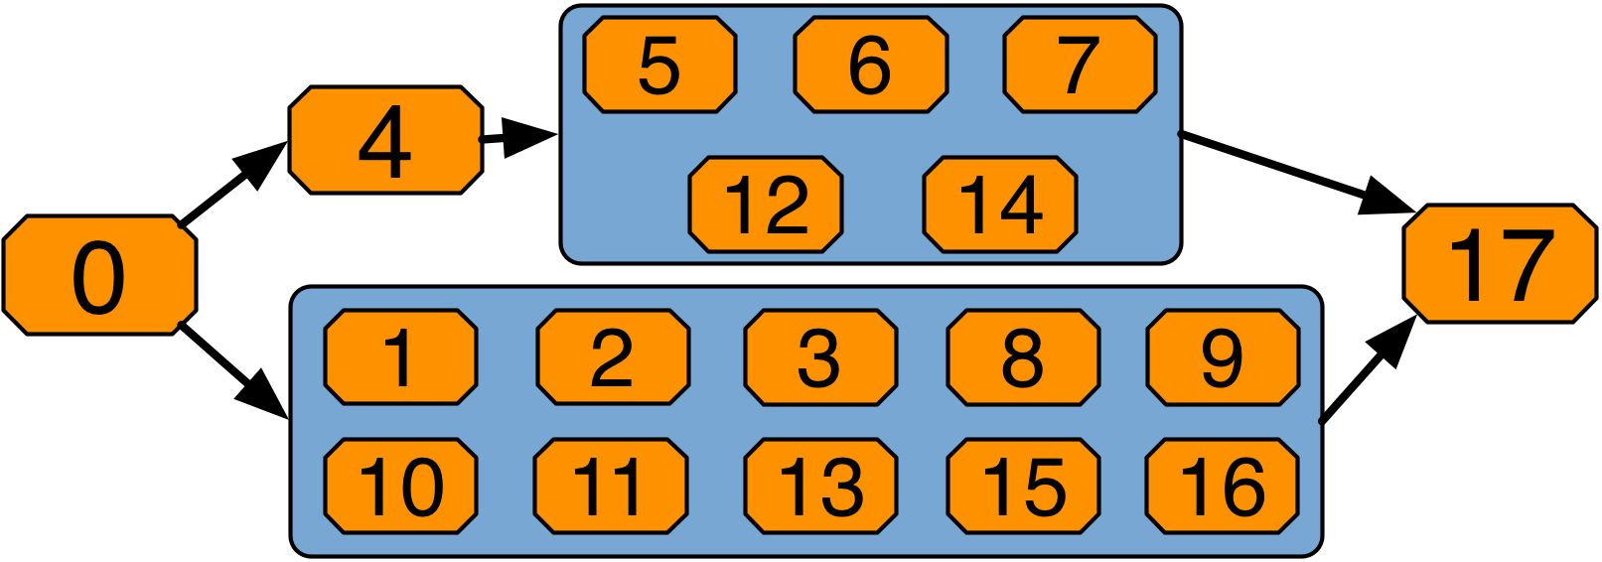
Case Study: ttH Scientific Data Analyses
Computational characteristics
18 propositions
Proposition 17 is the most compute intensive
Three versions of ttH
ttH_as – latency-bound
ttH_sci – compute-bound
ttH_scinp – compute-bound (less compute intensive than ttH_sci)
Notes:
Descrever os nomes do ttH

Slide 19
Testbed Environment
Ivy Bridge (IB) server: dual 12-core Intel Xeon E5-2695v2 @2.4 GHz nominal, coupled with a NVidia Tesla K20 with 2496 CUDA cores (Kepler) and a 61-core Intel Xeon Phi 7120 @1.2 GHz (KNC)
Broadwell (BW) server: dual 16-core Intel Xeon E5-2683v4 @2.1 GHz nominal (1.7 GHz nominal with AVX2)
Skylake server: dual 24-core Intel Xeon Platinum 8160 Skylake devices @2.1 GHz nominal (1.4 GHz nominal with AVX-512)
KNL server: single 64-core Intel Xeon Phi 7210 server @1.3 GHz nominal (1.1 GHz nominal with AVX-512) – configured with quadrant clustering and eRAM as flat

Slide 20
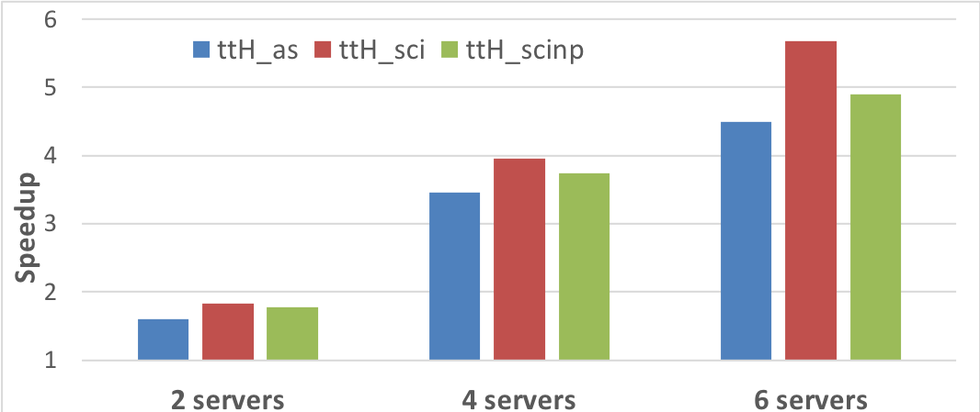
Multiprocess Scheduling Layer Evaluation
Speedup of the case studies for 2, 4 and 6 KNL servers vs a single KNL server

Slide 21
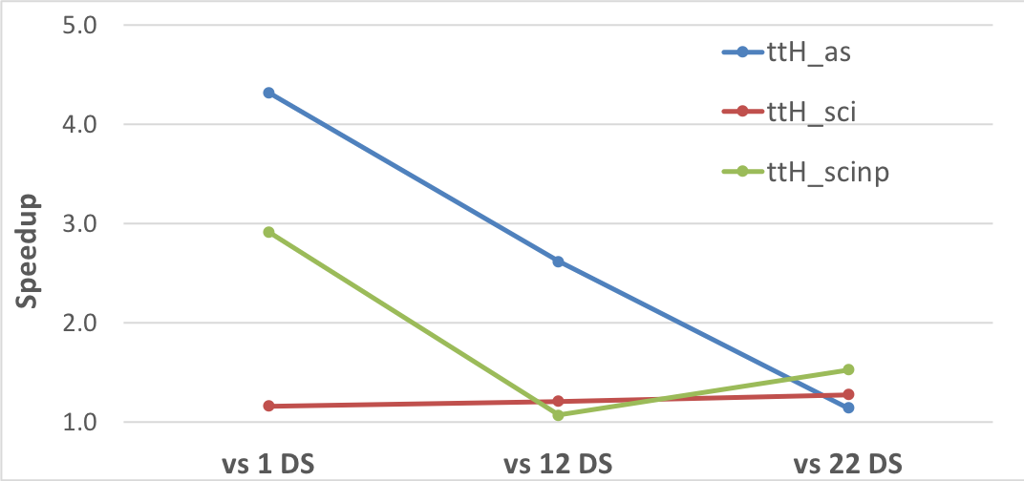
Simultaneous DS/DP Scheduling Layer Evaluation
Speedup of dynamic vs static tuning of DS and DP threads on the Ivy Bridge server

Slide 22
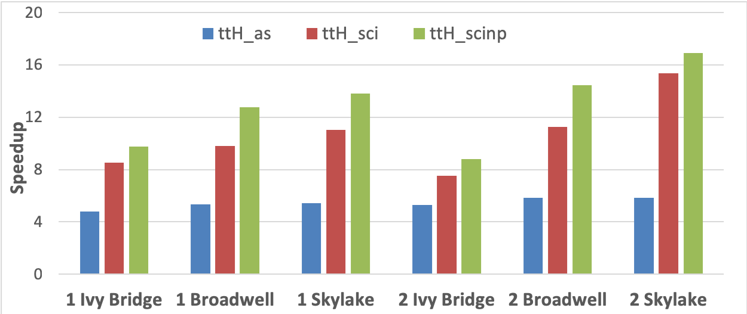
Multicore Scheduling Layer Evaluation
Speedup of the parallel ttH analyses with HEP-Frame vs a standard OpenMP parallelisation for the same number of threads

Slide 23
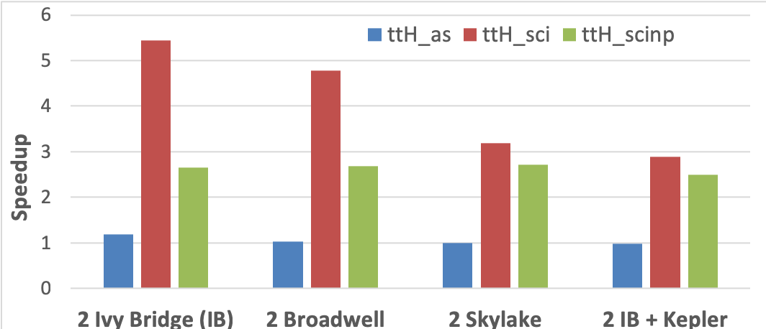
Manycore Scheduling Layer Evaluation
Speedup of the KNL server vs 3 multicore dual-socket servers and a 4th with a Kepler GPU

Slide 24
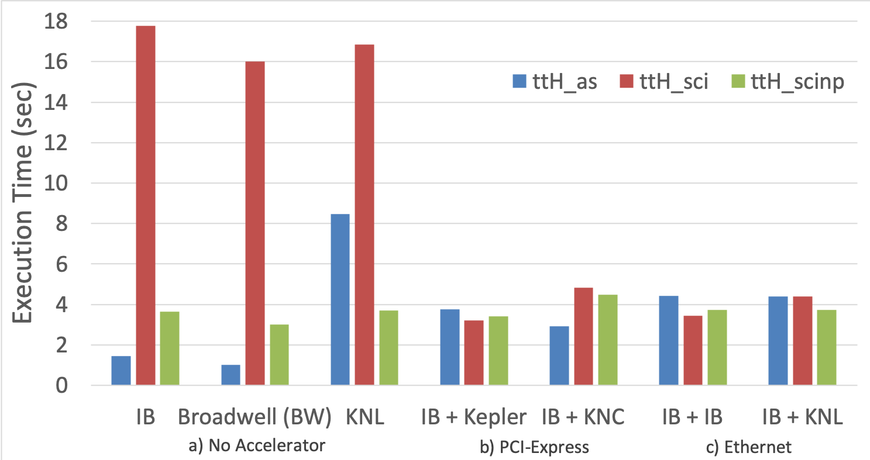
PRNG Management Evaluation
Execution of the ttH analyses with native PRNG and offloading the PRNG to devices/servers over PCI-Express and Ethernet (with no DS/DP sched.)

Slide 25
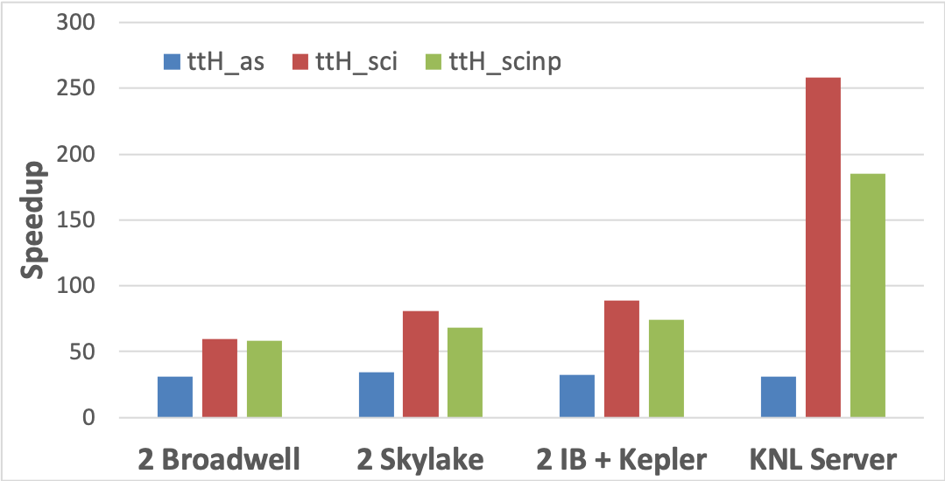
Overall HEP-Frame Evaluation
Speedup of the case studies on HEP-Frame vs their original sequential implementations

Slide 26
Conclusions
HEP-Frame is designed for pipelined data streaming applications
HEP-Frame multi-layer scheduler dynamically adapts the hardware and workloads
Each layer adapts code execution for different computing devices
Throughput improved from 56 to 14K dataset elements per sec

Slide 27
Future Work
HEP-Frame user interaction can be further improved through
An easier integration of plugins into the compile process
Automatic detection of dependencies among propositions
HEP-Frame performance can also be improved through
An improvement on the multicore scheduler to use multiple processes per server

Slide 28
Scientific Contributions
HEP-Frame is available at https://bitbucket.org/ampereira/hep-frame/
Currently used by several particle physicists
Scientific Communications
PRNG-broker: A High-Performance Broker to Supply Parallel Generated Streams of Pseudo-Random Numbers to Large Scale Simulations - André Pereira and Alberto Proença. To be submitted in May to the Journal of Scientific Computing.
Multi-layer Scheduling with Adaptive Ordering of Pipelined Data Stream Analyses on Heterogeneous Servers - André Pereira and Alberto Proença. Submitted in March to the Journal of Parallel and Distributed Computing.
HEP-Frame: a Powerful Tool to Build LHC Data Analyses - André Pereira, António Onofre and Alberto Proença. To be submitted in May to the European Physics Journal C.
Efficient Use of Parallel PRNGs on Heterogeneous Servers – André Pereira and Alberto Proença. In International Conference on Mathematical Applications, 2018.
Tuning Pipelined Scientific Data Analyses for Efficient Multicore Execution - André Pereira, António Onofre and Alberto Proença. In Proceedings of the International Conference on High Performance Computing Simulation, 2016.
HEP-Frame: A Software Engineered Framework to Aid the Development and Efficient Multicore Execution of Scientific Code - André Pereira, António Onofre and Alberto Proença. In Proceedings of the 2015 International Conference on Computational Science and Computational Intelligence, 2015.
Removing Inefficiencies from Scientific Code: The Study of the Higgs Boson Couplings to Top Quarks - André Pereira, António Onofre and Alberto Proença. In Proceedings of the 14th International Conference on Computational Science and Its Applications, 2014.

Slide 29
HEP-Frame
A Development Aid and Efficient Execution Engine where a Multi-layer Scheduler Adaptively Orders
Pipelined Data Stream Applications
Candidate:
André Pereira
Advisors:
Prof. Alberto Proença
Prof. António Onofre

Slide 30
Common Parallelisation Approaches
Multithread
Multiprocess

Slide 31
Processing with Accelerator Devices
Common approach
A more efficient approach
Notes:
Common approach is to offload compute intensive routines using existing libraries

